Slide 1
Data Analytics – Lesson 21 Sentiment Modeling using R
Jeffrey Strickland, Ph.D., CMSP, ASEP
CEO Humalytica Analytics

Slide 2
Text Formats for Analysis
Corpus
Tidy
a large and structured set of texts
used to do statistical analysis and hypothesis testing
validating linguistic rules within a specific language territory
may contain texts in a single language (monolingual corpus)
may contain texts in multiple languages (multilingual corpus).
keeps one token (typically a word) in each row
keeps each variable (such as a document or chapter) in a column.
When your data is tidy, you can use a common set of tools for exploring and visualizing them
This frees you from struggling to get your data into the right format for each task
lets you focus on the questions you want to ask.

Slide 3
Tidy the text
Step 1: put the text into a data frame
R code for the data frame
the c() function returns a vector (a one dimensional array)
Paste0() concatenates strings without spaces
the data_frame() function is used for storing data tables
The map() function transforms the text by applying a function to each element and returning a vector the same length
read_lines() reads up to n_max lines from a file. ... read_lines_raw() produces a list of raw vectors
the Mutate adds new variables and preserves existing
quantum_words<-
data_frame(file =
paste0("~/VIT_University/tidy_text/",
c("quantum_phaith.txt
"quantum_hope.txt“
"quantum_love.txt"))) %>%
mutate(text = map(file, read_lines))

Slide 4
Tidy the text
Step 2: Unnest the tibble
R code for unnesting a data frame
Tibbles are new data frames that keep the features we like and drops the features that arenow frustrating (i.e. converting character vectors to factors).
unnest() the tibble
remove the lines that are LaTeX crude (either start with \[A-Z] or \[a-z], like \section or \figure)
compute a line number with the mutate function
quantum_words <- quantum_words %>%
unnest() %>%
filter(text != "%!TEX root =
quantum.tex") %>%
filter(!str_detect(text,
"^(\\\\[A-Z,a-z])"),
text != "") %>%
mutate(line_number = 1:n(),
file =
str_sub(basename(file), 1, -5))

Slide 5
Tidy the text
Step 3: Delete words and LaTex
Words needing to be deleted
str_detect() detects the presence or absence of a pattern and returns a logical vector
! is the logical operator for negation
quantum_words <- quantum_words %>%
unnest_tokens(word, text) %>%
filter(!str_detect(word, "[0-9]"),
word != "fismanreview",
word != "multicolumn",
word != "p",
word != "_i",
...
!str_detect(word, "textless"))

Slide 6
tidytext
Provides means for
Functionality sample
text mining for word processing
text mining for sentiment analysis
tidy data has a specific structure:
each variable is a column
each observation is a row
each type of observational unit is a table
Calculate and bind the term frequency and inverse document frequency
Tidy a corpus object from the quanteda package
Get speciﬁc sentiment lexicons in a tidy format
Get a speciﬁc stop word lexicon
English negators, modals, and adverbs, as a dataframe

Slide 7
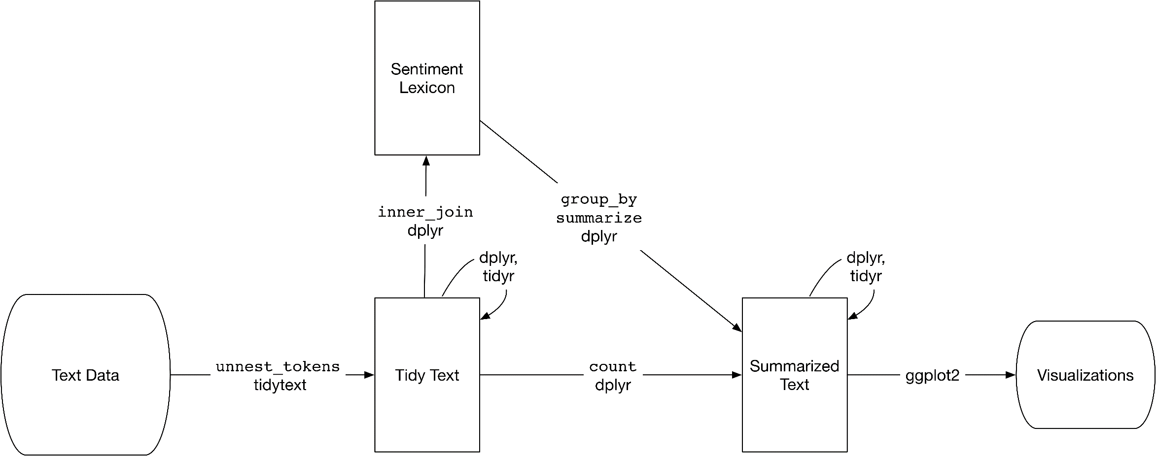
Sentiment Analysis: tidytext example
Sentiment analysis is not equal to opinion mining
Opinions are established over a longer period of time
Sentiment is an immediate emotional response
We can use the tools of text mining to approach the emotional content of text programmatically

Slide 8
The Approach
One way to analyze the sentiment of a text is:
consider the text as a combination of its individual words and
the sentiment content of the whole text as the sum of the sentiment content of the individual words
This is a commonly used approach sentiment analysis
This approach that naturally takes advantage of the tidy tool ecosystem

Slide 9
The Data
The tidytext package contains several sentiment lexicons in the sentiments dataset.
The three general-purpose lexicons are
AFINN from Finn Årup Nielsen,
bing from Bing Liu and collaborators, and
nrc from Saif Mohammad and Peter Turney.
All three of these lexicons are based on unigrams, i.e., single words.
library(tidytext)
sentiments
## # A tibble: 27,314 x 4
## word sentiment lexicon score
## <chr> <chr> <chr> <int>
## 1 abacus trust nrc NA
## 2 abandon fear nrc NA
## 3 abandon negative nrc NA
## 4 abandon sadness nrc NA
## 5 abandoned anger nrc NA
## 6 abandoned fear nrc NA
## 7 abandoned negative nrc NA
## 8 abandoned sadness nrc NA
## 9 abandonment anger nrc NA
## 10 abandonment fear nrc NA
## # ... with 27,304 more rows

Slide 10
nrc Lexicon
These lexicons contain many English words and the words are assigned scores for positive/negative sentiment, and also possibly emotions like joy, anger, sadness, and so forth.
Includes 13,901 words
The nrc lexicon categorizes words in a binary fashion (“yes”/“no”) into categories of:
Positive
Negative
Anger
Fear
Joy
Sadness
Surprise
Trust
get_sentiments("nrc")
## # A tibble: 13,901 x 2
## word sentiment
## <chr> <chr>
## 1 abacus trust
## 2 abandon fear
## 3 abandon negative
## 4 abandon sadness
## 5 abandoned anger
## 6 abandoned fear
## 7 abandoned negative
## 8 abandoned sadness
## 9 abandonment anger
## 10 abandonment fear
## # ... with 13,891 more rows

Slide 11
bing Lexicon
These lexicons contain many English words and the words are assigned scores for positive/negative sentiment, and also possibly emotions like joy, anger, sadness, and so forth
Includes 6,788 words
The bing lexicon categorizes words in a binary fashion into positive and negative categories
get_sentiments("bing")
## # A tibble: 6,788 x 2
## word sentiment
## <chr> <chr>
## 1 2-faced negative
## 2 2-faces negative
## 3 a+ positive
## 4 abnormal negative
## 5 abolish negative
## 6 abominable negative
## 7 abominably negative
## 8 abominate negative
## 9 abomination negative
## 10 abort negative
## # ... with 6,778 more rows

Slide 12
AFINN Lexicon
These lexicons contain many English words and the words are assigned scores for positive/negative sentiment, and also possibly emotions like joy, anger, sadness, and so forth.
Includes 2,476 words
The AFINN lexicon assigns words with a score that runs between -5 and 5 with
negative scores indicating negative sentiment
positive scores indicating positive sentiment.
get_sentiments("afinn")
## # A tibble: 2,476 x 2
## word score
## <chr> <int>
## 1 abandon -2
## 2 abandoned -2
## 3 abandons -2
## 4 abducted -2
## 5 abduction -2
## 6 abductions -2
## 7 abhor -3
## 8 abhorred -3
## 9 abhorrent -3
## 10 abhors -3
## # ... with 2,466 more rows

Slide 13
How were these sentiment lexicons put together and validated?
They were constructed via
crowdsourcing (using, for example, Amazon Mechanical Turk)
by the labor of one of the authors
Were validated using some combination of crowdsourcing again, restaurant or movie reviews, or Twitter data.
Given this information, we should hesitate to apply these sentiment lexicons to styles of text dramatically different from what they were validated on, such as narrative fiction from 200 years ago.
There are also some domain-specific sentiment lexicons available, constructed to be used with text from a specific content area.

Slide 14
Performing sentiment analysis is an inner join operation
With data in a tidy format, sentiment analysis can be done as an inner join
Let’s look at the words with a joy score from the NRC lexicon.
What are the most common joy words in Emma?
First, we need to take the text of the novels and convert the text to the tidy format using unnest_tokens()
Let’s also set up some other columns to keep track of which line and chapter of the book each word comes from
we use group_by and mutate to construct those columns.
library(janeaustenr)
library(dplyr)
library(stringr)
tidy_books <- austen_books() %>%
group_by(book) %>%
mutate(linenumber = row_number(),
chapter = cumsum(str_detect(tex t, regex("^chapter [\\divxlc]",
ignore_case = TRUE)))) %>%
ungroup() %>%
unnest_tokens(word, text)

Slide 15
Tidy Sentiment Analysis
Now that the text is in a tidy format with one word per row, we are ready to do the sentiment analysis.
Use the NRC lexicon and filter() for the joy words.
Filter() the data frame with the text from the books for the words from Emma and then use inner_join() to perform the sentiment analysis.
What are the most common joy words in Emma?
Use count() from dplyr.
nrc_joy <- get_sentiments("nrc") %>%
filter(sentiment == "joy")
tidy_books %>%
filter(book == "Emma") %>%
inner_join(nrc_joy) %>%
count(word, sort = TRUE)
## # A tibble: 303 x 2
## word n
## <chr> <int>
## 1 good 359
## 2 young 192
## 3 friend 166
## 4 hope 143
## 5 happy 125
## 6 love 117
## 7 deal 92
## 8 found 92
## 9 present 89
## 10 kind 82
## # ... with 293 more rows
mostly positive, happy words about hope, friendship, and love here

Slide 16
Scoring using the bing lexicon & inner join
We can also examine how sentiment changes throughout each novel. We can do this with just a handful of lines that are mostly dplyr functions.
First, we find a sentiment score for each word using the Bing lexicon and inner_join().
Next, we count up how many positive and negative words there are in defined sections of each book.
We define an index here to keep track of where we are in the narrative; this index (using integer division) counts up sections of 80 lines of text.

Slide 17
R Procedure
The %/% operator does integer division (x %/% y is equivalent to floor(x/y))
So the index keeps track of which 80-line section of text we are counting up negative and positive sentiment in.
Small sections of text may not have enough words in them to get a good estimate of sentiment while really large sections can wash out narrative structure.
For these books, using 80 lines works well, but this can vary depending on individual texts, how long the lines were to start with, etc.
We then use spread() so that we have negative and positive sentiment in separate columns, and lastly calculate a net sentiment (positive - negative).
library(tidyr)
jane_austen_sentiment <- tidy_books %>%
inner_join(get_sentiments("bing")) %>%
count(book, index = linenumber %/% 80, sentiment) %>%
spread(sentiment, n, fill = 0) %>%
mutate(sentiment = positive - negative)

Slide 18
Plotting Sentiment with R
Now we can plot these sentiment scores across the plot trajectory of each novel.
Notice that we are plotting against the index on the x-axis that keeps track of narrative time in sections of text.
library(ggplot2)
ggplot(jane_austen_sentiment, aes(in dex, sentiment, fill = book)) + geom_col(show.legend = FALSE) +
facet_wrap(~book, ncol = 2,
scales = "free_x")

Slide 19
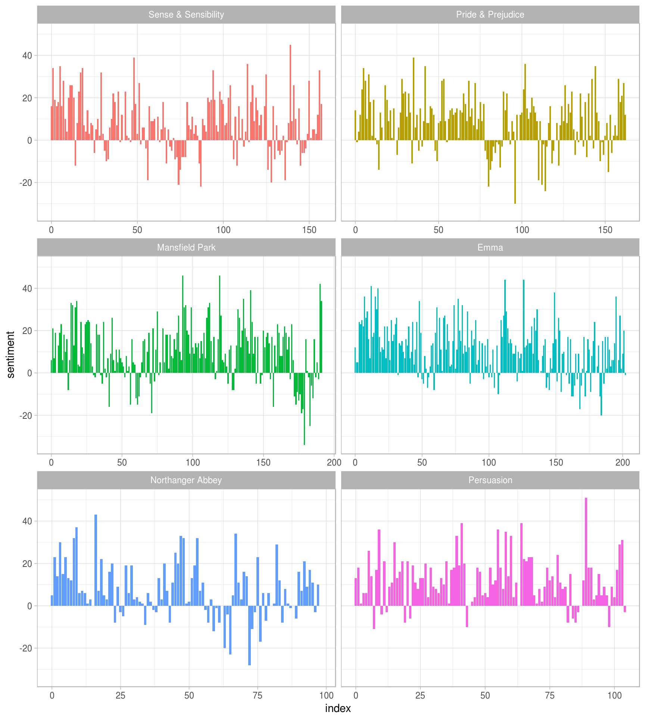
Sentiment Plots
We can see how the plot of each novel changes toward more positive or negative sentiment over the trajectory of the story.

Slide 20
Comparing the three sentiment dictionaries
With several options for sentiment lexicons, we might want some more information on which one is appropriate for our purposes.
Let’s use all three sentiment lexicons and examine how the sentiment changes across the narrative arc of Pride and Prejudice.
First, let’s use filter() to choose only the words from the one novel we are interested in.

Slide 21
Text: Pride & Prejudice
pride_prejudice <- tidy_books %>%
filter(book == "Pride & Prejudice")
pride_prejudice
## # A tibble: 122,204 x 4
## book linenumber chapter word
## <fct> <int> <int> <chr>
## 1 Pride & Prejudice 1 0 pride
## 2 Pride & Prejudice 1 0 and
## 3 Pride & Prejudice 1 0 prejudice
## 4 Pride & Prejudice 3 0 by
## 5 Pride & Prejudice 3 0 jane
## 6 Pride & Prejudice 3 0 austen
## 7 Pride & Prejudice 7 1 chapter
## 8 Pride & Prejudice 7 1 1
## 9 Pride & Prejudice 10 1 it
## 10 Pride & Prejudice 10 1 is
## # ... with 122,194 more rows

Slide 22
AFINN Lexicon & Inner Join
Now, we can use inner_join() to calculate the sentiment in different ways.
Remember from above that the AFINN lexicon measures sentiment with a numeric score between -5 and 5, while the other two lexicons categorize words in a binary fashion, either positive or negative.
To find a sentiment score in chunks of text throughout the novel, we will need to use a different pattern for the AFINN lexicon than for the other two.
Let’s again use integer division (%/%) to define larger sections of text that span multiple lines, and we can use the same pattern with count(), spread(), and mutate() to find the net sentiment in each of these sections of text.

Slide 23
R Procedure for AFINN Lexicon
afinn <- pride_prejudice %>%
inner_join(get_sentiments("afinn")) %>%
group_by(index = linenumber %/% 80) %>%
summarise(sentiment = sum(score)) %>%
mutate(method = "AFINN")
bing_and_nrc <- bind_rows(pride_prejudice %>%
inner_join(get_sentiments("bing")) %>%
mutate(method = "Bing et al."),
pride_prejudice %>%
inner_join(get_sentiments("nrc") %>%
filter(sentiment %in% c("positive",
"negative"))) %>%
mutate(method = "NRC")) %>%
count(method, index = linenumber %/% 80, sentiment) %>%
spread(sentiment, n, fill = 0) %>%
mutate(sentiment = positive - negative)

Slide 24
R Procedure for AFINN Lexicon
We now have an estimate of the net sentiment (positive - negative) in each chunk of the novel text for each sentiment lexicon
Let’s bind them together and visualize them
bind_rows(afinn,
bing_and_nrc) %>%
ggplot(aes(index, sentiment, fill = method)) +
geom_col(show.legend = FALSE) +
facet_wrap(~method, ncol = 1, scales = "free_y")

Slide 25
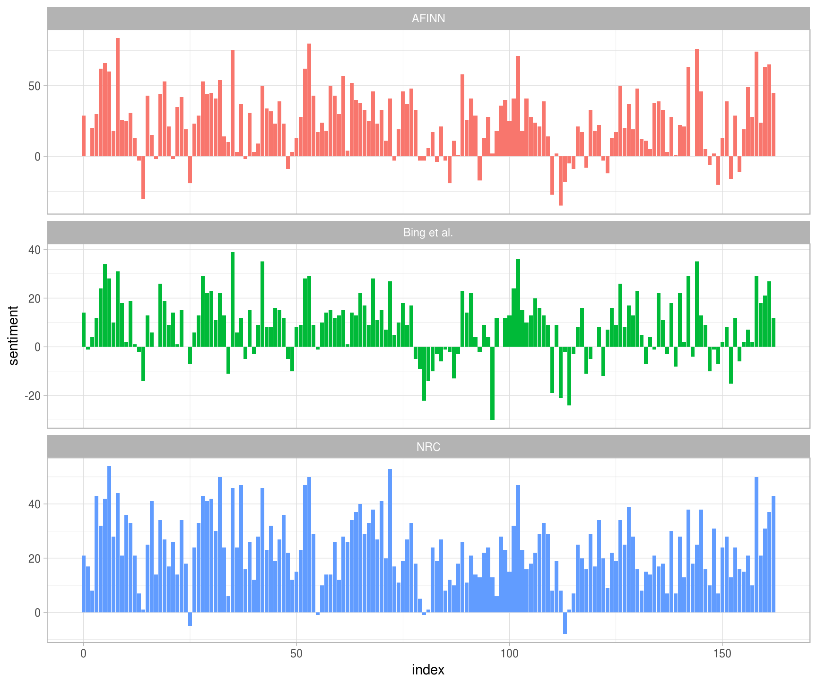
Lexicon Comparison
The plot shows positive sentiment (above 0) and negative sentiment (below 0) for three lexicons.
The lexicons are for English (United States) and may not be culturally relevant for all analyses.

Slide 26
www.humalytica.com
http://www.amazon.com/Jeffrey-Strickland/e/B00IQ69QZK/
http://www.lulu.com/spotlight/strickland_jeffrey

